Slide 1

Network+ Guide to Networks 6th Edition
Chapter 6
Network Hardware, Switching, and Routing

Slide 2
Objectives
Identify the functions of LAN connectivity hardware
Install, configure, and differentiate between network devices such as NICs, hubs, bridges, switches, routers, and gateways
Explain the advanced features of a switch and understand popular switching techniques, including VLAN management
Explain the purposes and properties of routing
Describe common IPv4 and IPv6 routing protocols

Slide 3
NICs (Network Interface Cards)
Connectivity devices
Enable device transmission
Transceiver
Transmits and receives data
Physical layer and Data Link layer functions
Issue data signals
Assemble and disassemble data frames
Interpret physical addressing information
Determine right to transmit data

Slide 4
NICs (cont’d.)
Smart hardware
Prioritization
Network management
Buffering
Traffic-filtering
Do not analyze information
Added by Layers 3 through 7 OSI model protocols
Importance
Common to every networking device, network

Slide 5
Types of NICs
Before ordering or installing NIC
Know device interface type
NIC dependencies
Access method
Network transmission speed
Connector interfaces
Compatible motherboard or device type
Manufacturer
Support for enhanced features

Slide 6
Types of NICs (cont’d.)
Bus
Circuit, signaling pathway
Motherboard uses to transmit data to computer’s components
Memory, processor, hard disk, NIC
Differ according to capacity
Defined by data path width and clock speed
Data path size
Parallel bits transmitting at any given time
Proportional to attached device’s speed

Slide 7
Types of NICs (cont’d.)
Expansion slots
Multiple electrical contacts on motherboard
Allow bus expansion
Expansion card (expansion board)
Circuit board for additional devices
Inserts into expansion slot, establishes electrical connection
Device connects to computer’s main circuit or bus
Computer centrally controls device

Slide 8
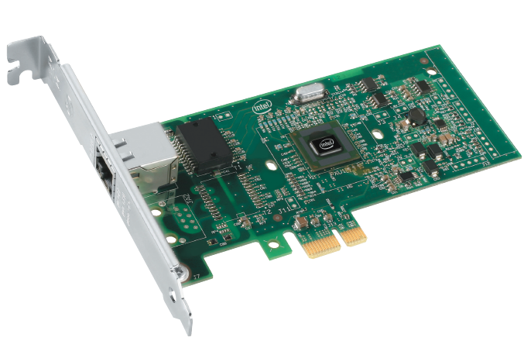
Types of NICs (cont’d.)
Multiple bus types
PCIe bus: most popular expansion board NIC
PCIe (Peripheral Component Interconnect Express)
32-bit bus
Maximum data transfer rate: 1 Gbps
Introduced in 2004
Figure 6-1 PCIe expansion board NIC
Courtesy of Intel Corporation

Slide 9
Types of NICs (cont’d.)
Determining bus type
Read documentation
Look inside PC case
If more than one expansion slot type:
Refer to NIC, PC manufacturers’ guidelines
Choose NIC matching most modern bus

Slide 10
Types of NICs (cont’d.)
Peripheral NICs
Attached externally
Simple installation into a variety of slots
PCMCIA
USB
CompactFlash
FireWire
Installing and configuring software may be required

Slide 11

Types of NICs (cont’d.)
Figure 6-2 A USB NIC
© Charles B. Ming Onn/Shutterstock.com

Slide 12
Types of NICs (cont’d.)
On-Board NICs
Connect device directly to motherboard
On-board ports: mouse, keyboard
New computers, laptops
Use onboard NICs integrated into motherboard
Advantages
Saves space
Frees expansion slots

Slide 13
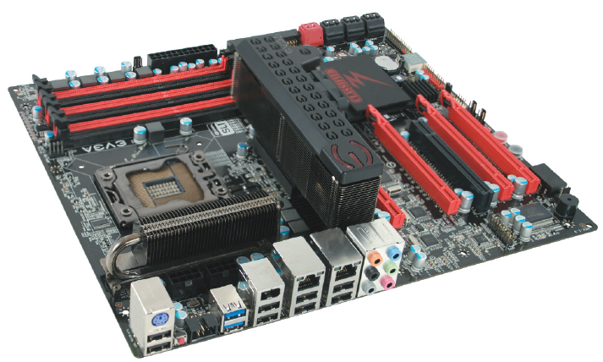
Types of NICs (cont’d.)
Figure 6-3 Motherboard with on-board NICs
Courtesy of EVGA USA

Slide 14
Installing and Configuring NICs
Installing NIC hardware
Read manufacturer’s documentation
Install expansion card NIC
Gather needed tools
Unplug computer, peripherals, and network cable
Ground yourself
Open computer case
Select slot, insert NIC, attach bracket, verify cables
Replace cover, turn on computer
Configure NIC software

Slide 15
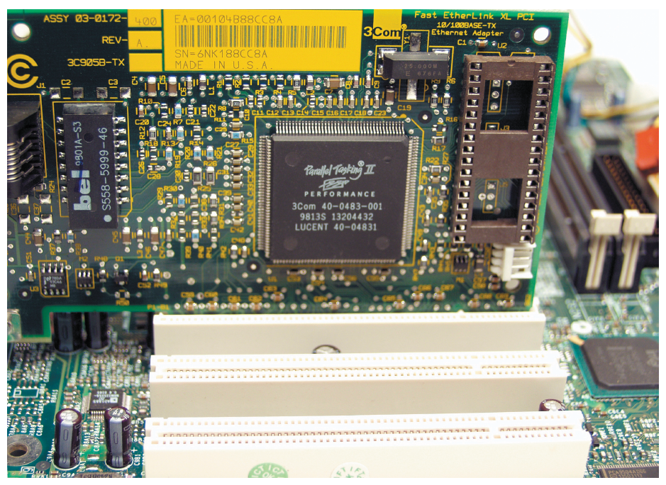
Installing and Configuring NICs (cont’d.)
Figure 6-4 A properly inserted expansion board NIC
Courtesy of Gary Herrington Photography

Slide 16
Installing and Configuring NICs (cont’d.)
Installing and configuring NIC software
Device driver
Software enabling device to communicate with operating system
Purchased computer with a peripheral
Drivers installed
Add hardware to computer
Must install drivers

Slide 17
Installing and Configuring NICs (cont’d.)
Operating system built-in drivers
Automatically recognize hardware, install drivers
Drivers not available from operating system
Install and configure NIC software
Available at manufacturer’s Web site

Slide 18
Installing and Configuring NICs (cont’d.)
Verifying NIC functionality
Check whether device can communicate with network
Diagnostic tools
Use manufacturer’s configuration utility
Loopback plug needed
Visual inspection of LEDs
Read manufacturer’s documentation
Use simple commands
Example: pinging the loopback address

Slide 19
Modular Interfaces
Hot-swappable components
Can be changed without disrupting operations
GBIC (Gigabit interface converter)
Standard type of modular interface
May contain RJ-45 or fiber-optic cable ports
SFPs (small form-factor pluggable)
Provide same form factor as GBIC
Allow more ports per inch

Slide 20
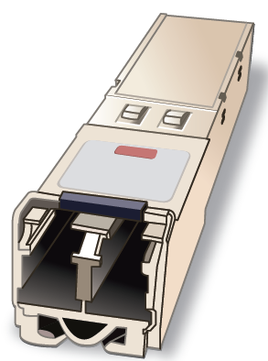
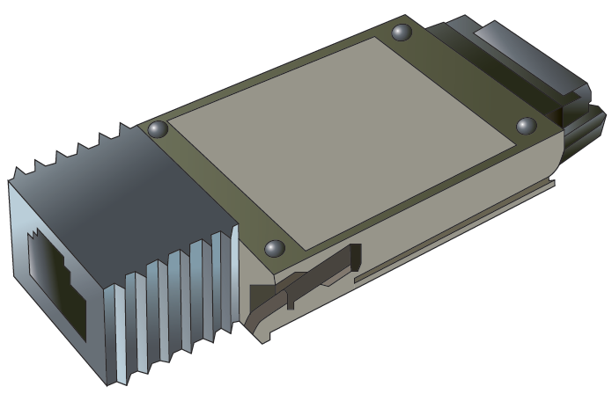
Modular Interfaces (cont’d.)
Figure 6-7 GBIC (Gigabit interface converter) with an RJ-45 port
Figure 6-8 SFP (small form-factor pluggable) transceiver for use with fiber connections
Courtesy Course Technology/Cengage Learning
Courtesy Course Technology/Cengage Learning

Slide 21
Repeaters and Hubs
Repeaters
Operate in Physical OSI model layer
No means to interpret data
Regenerate signal
Hub
Repeater with more than one output port
Typically contains multiple data ports
Patch cables connect printers, servers, and workstations
Most contain uplink port

Slide 22
Bridges
Devices that connect two network segments
Analyze incoming frames
Make decisions on where to direct them
Operate at Data Link OSI model layer
Single input and single output ports
Protocol independent
Filtering database
Contains known MAC addresses and network locations

Slide 23
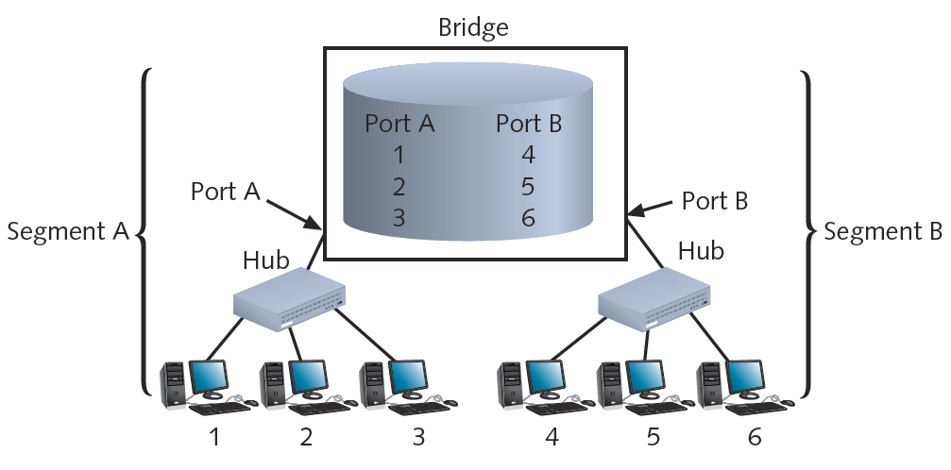
Bridges (cont’d.)
Figure 6-10 A bridge’s use of a filtering database
Courtesy Course Technology/Cengage Learning

Slide 24
Switches
Connectivity devices that subdivide a network
Segments
Traditional switches
Operate at Data Link OSI model layer
Modern switches
Can operate at Layer 3 or Layer 4
Switches interpret MAC address information
Common switch components
Internal processor, operating system, memory, ports

Slide 25
Switch Installation
Follow manufacturer’s guidelines
General steps (assume Cat 5 or better UTP)
Verify switch placement
Turn on switch
Verify lights, self power tests
Configure (if necessary)
Connect NIC to a switch port (repeat for all nodes)
After all nodes connected, turn on nodes
Connect switch to larger network (optional)

Slide 26
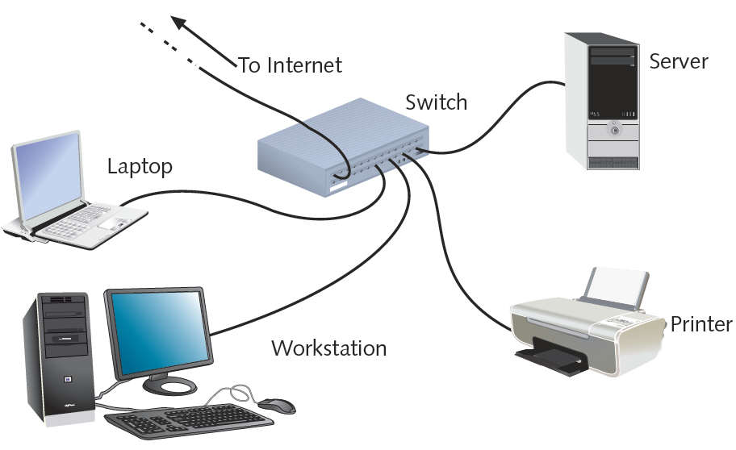
Switch Installation (cont’d.)
Figure 6-13 A switch on a small network
Courtesy Course Technology/Cengage Learning

Slide 27
Switching Methods
Difference in switches
Incoming frames interpretation
Frame forwarding decisions making
Four switching modes exist
Two basic methods discussed
Cut-through mode
Store-and-forward mode

Slide 28
Switching Methods (cont’d.)
Cut-through mode
Switch reads frame’s header
Forwarding decision made before receiving entire packet
Uses frame header: first 14 bytes contains destination MAC address
Cannot verify data integrity using frame check sequence
Can detect erroneously shortened packets (runts)
Runt detected: wait for integrity check

Slide 29
Switching Methods (cont’d.)
Cut-through mode (cont’d.)
Cannot detect corrupt packets
Advantage: speed
Disadvantage
Data buffering (switch flooded with traffic)
Best use
Small workgroups needing speed
Low number of devices

Slide 30
Switching Methods (cont’d.)
Store-and-forward mode
Switch reads entire data frame into memory
Checks for accuracy before transmitting information
Transmit data more accurately than cut-through mode
Slower than cut-through mode
Best uses
Larger LAN environments; mixed environments
Can transfer data between segments running different transmission speeds

Slide 31
VLANs and Trunking
VLANs (virtual local area networks)
Logically separate networks within networks
Groups ports into broadcast domain
Broadcast domain
Port combination making a Layer 2 segment
Ports rely on Layer 2 device to forward broadcast frames
Collision domain
Ports in same broadcast domain
Do not share single channel

Slide 32
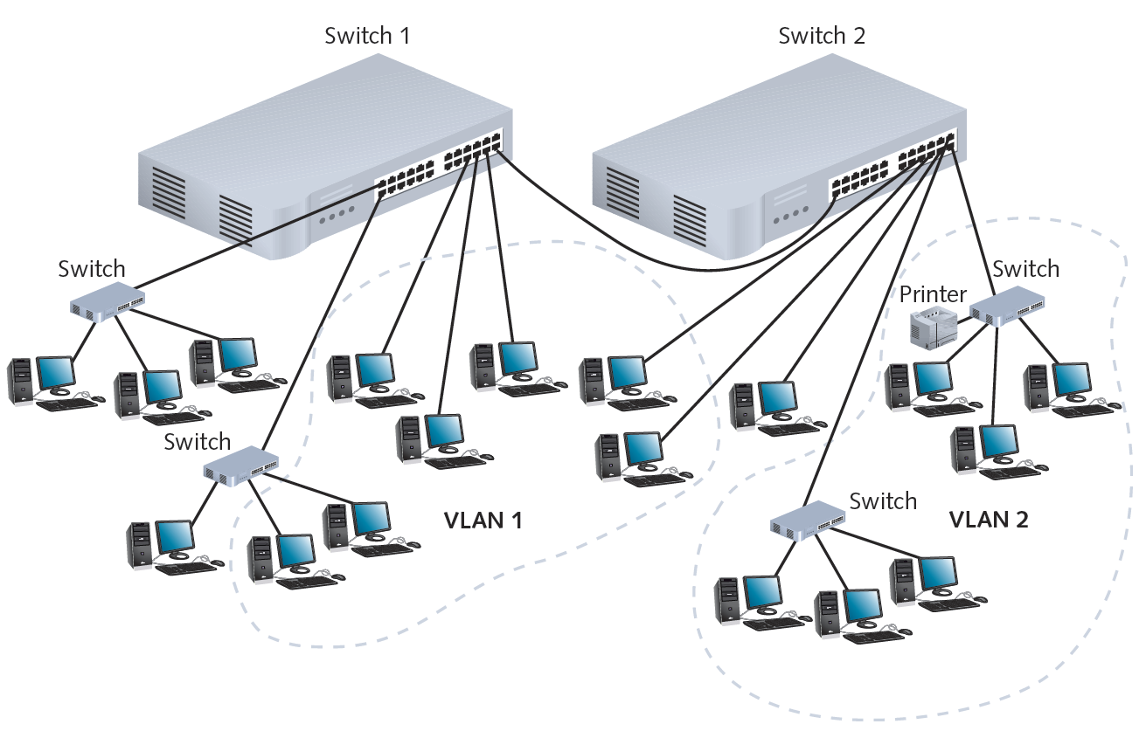
Figure 6-14 A simple VLAN design
Courtesy Course Technology/Cengage Learning

Slide 33
VLANs and Trunking (cont’d.)
Advantage of VLANs
Flexible
Ports from multiple switches or segments
Use any end node type
Reasons for using VLAN
Separating user groups
Isolating connections
Identifying priority device groups
Grouping legacy protocol devices
Separating large network into smaller subnets

Slide 34
VLANs and Trunking (cont’d.)
Switch typically preconfigured
One default VLAN
Cannot be deleted or renamed
Create additional VLANs
Indicate to which VLAN each port belongs
Additional specifications
Security parameters, filtering instructions, port performance requirements, network addressing and management options
Maintain VLAN using switch software

Slide 35
VLANs and Trunking (cont’d.)
Potential problem
Cutting off group from rest of network
Correct by using router or Layer 3 switch
Trunking
Switch’s interface carries traffic of multiple VLANs
Trunk
Single physical connection between switches
VLAN data separation
Frame contains VLAN identifier in header

Slide 36
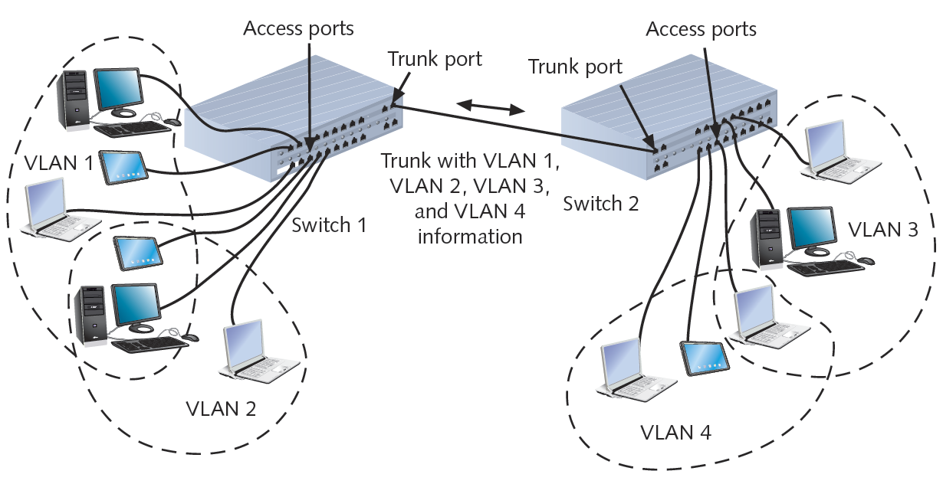
VLANs and Trunking (cont’d.)
Figure 6-16 Trunk for multiple VLANs
Courtesy Course Technology/Cengage Learning

Slide 37
STP (Spanning Tree Protocol)
IEEE standard 802.1D
Operates in Data Link layer
Prevents traffic loops
Calculating paths avoiding potential loops
Artificially blocking links completing loop
Three steps
Select root bridge based on Bridge ID
Examine possible paths between network bridge and root bridge
Disables links not part of shortest path

Slide 38
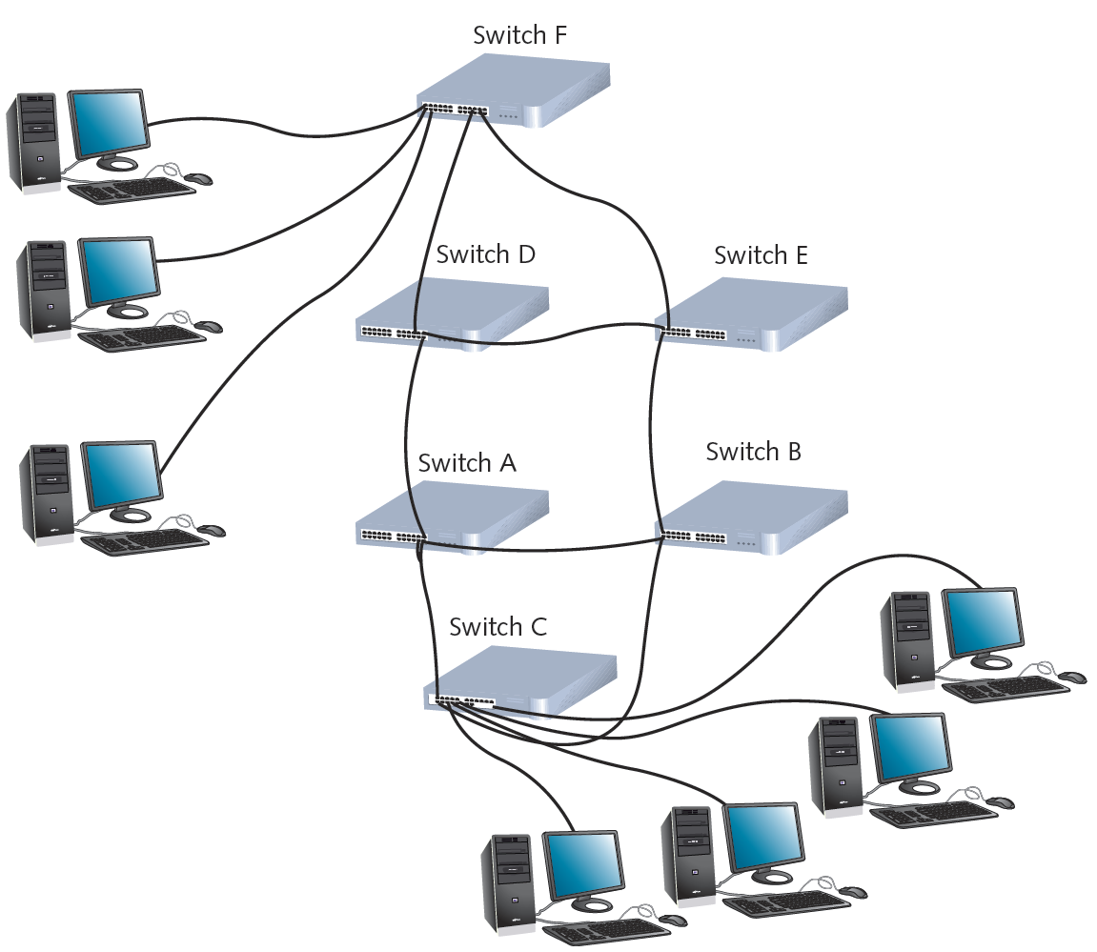
Figure 6-17 Enterprise-wide switched network
Courtesy Course Technology/Cengage Learning

Slide 39
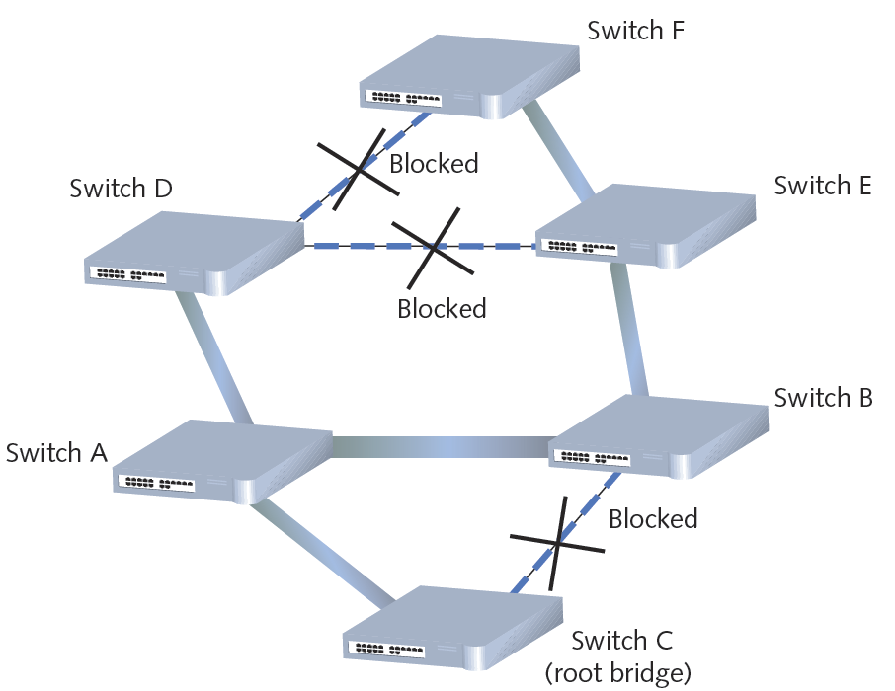
Figure 6-18 STP-selected paths on a switched network
Courtesy Course Technology/Cengage Learning

Slide 40
STP (cont’d.)
History
Introduced in 1980s
Original STP too slow
RSTP (Rapid Spanning Tree Protocol)
Newer version
IEEE’s 802.1w standard
Cisco and Extreme Networks
Proprietary versions
No enabling or configuration needed
Included in switch operating software

Slide 41
Content and Multilayer Switches
Layer 3 switch (routing switch)
Interprets Layer 3 data
Layer 4 switch
Interprets Layer 4 data
Content switch (application switch)
Interprets Layer 4 through Layer 7 data
Advantages
Advanced filtering
Keeping statistics
Security functions

Slide 42
Content and Multilayer Switches (cont’d.)
Distinguishing between Layer 3 and Layer 4 switch
Manufacturer dependent
Higher-layer switches
Cost more than Layer 2 switches
Used in network backbone

Slide 43
Routers
Multiport connectivity device
Directs data between network nodes
Integrates LANs and WANs
Different transmission speeds, protocols
Operate at Network layer (Layer 3)
Directs data from one segment or network to another
Logical addressing
Protocol dependent
Slower than switches and bridges
Need to interpret Layers 3 and higher information

Slide 44
Routers (cont’d.)
Traditional stand-alone LAN routers
Being replaced by Layer 3 routing switches
New niche
Specialized applications
Linking large Internet nodes
Completing digitized telephone calls

Slide 45
Router Characteristics and Functions
Intelligence
Tracks node location
Determine shortest, fastest path between two nodes
Connects dissimilar network types
Large LANs and WANs
Routers indispensable
Router components
Internal processor, operating system, memory, input and output jacks, management control interface

Slide 46
Router Characteristics and Functions (cont’d.)
Multiprotocol routers
Multiple slots
Accommodate multiple network interfaces
Inexpensive routers
Home, small office use

Slide 47
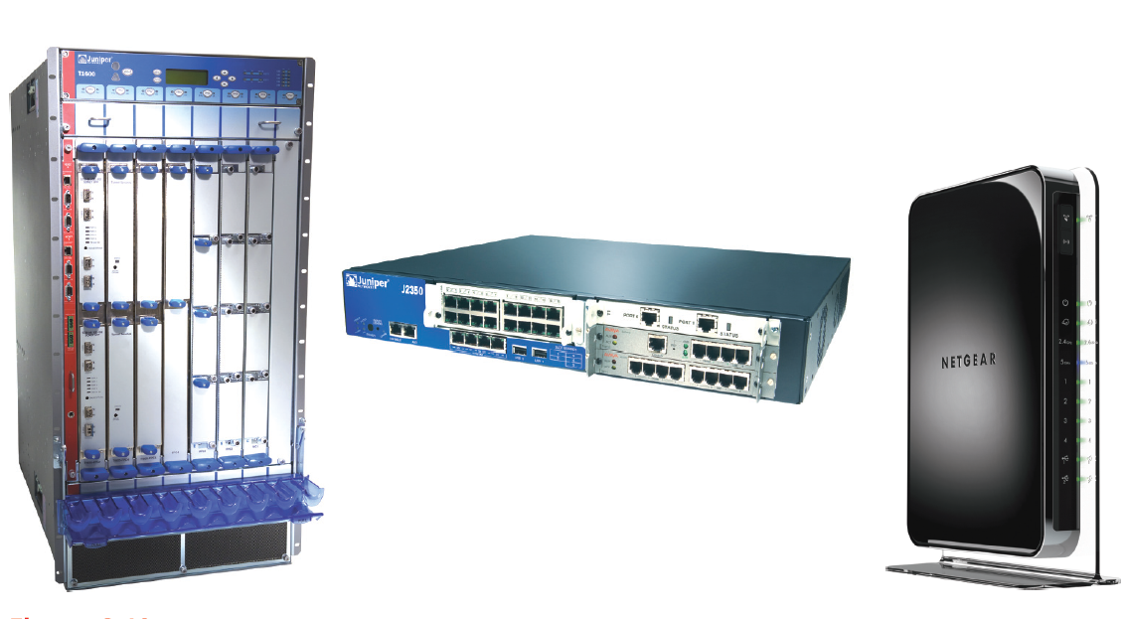
Figure 6-19 Routers
Courtesy Course Technology/Cengage Learning

Slide 48
Router Characteristics and Functions (cont’d.)
Router capabilities
Connect dissimilar networks
Interpret Layer 3 addressing
Determine best data path
Reroute traffic

Slide 49
Router Characteristics and Functions (cont’d.)
Optional router functions
Filter broadcast transmissions
Enable custom segregation, security
Support simultaneous connectivity
Provide fault tolerance
Monitor network traffic
Diagnose problems and trigger alarms

Slide 50
Router Characteristics and Functions (cont’d.)
Interior router
Directs data between nodes on a LAN
Exterior router
Directs data between nodes external to a LAN
Border routers
Connect autonomous LAN with a WAN
Routing tables
Identify which routers serve which hosts

Slide 51
Router Characteristics and Functions (cont’d.)
Static routing
Router configured to use specific path between nodes
Dynamic routing
Automatically calculates best path between nodes
Installation
Simple for small office or home office LANs
Web-based configuration
Challenging for sizable networks

Slide 52
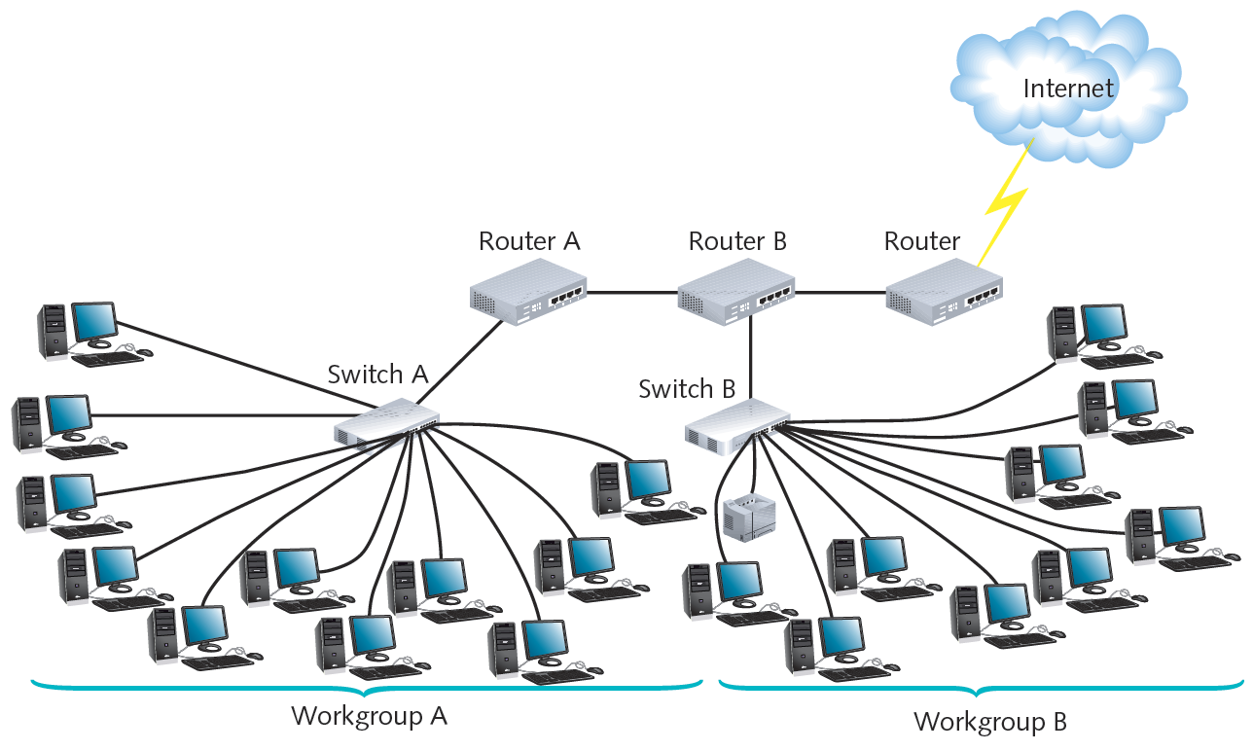
Figure 6-20 The placement of routers on a LAN
Courtesy Course Technology/Cengage Learning

Slide 53
Routing Protocols
Best path
Most efficient route from one node to another
Dependent on:
Hops between nodes
Current network activity
Unavailable link
Network transmission speed
Topology
Determined by routing protocol

Slide 54
Routing Protocols (cont’d.)
Routing metric factors
Number of hops
Throughput on potential path
Delay on a potential path
Load (traffic)
Maximum transmission unit (MTU)
Cost
Reliability of potential path

Slide 55
Routing Protocols (cont’d.)
Router convergence time
Time router takes to recognize best path
Change or network outage event
Distinguishing feature
Overhead; burden on network to support routing protocol

Slide 56
Routing Protocols (cont’d.)
Distance-vector routing protocols
Determine best route based on distance to destination
Factors
Hops, latency, network traffic conditions
RIP (Routing Information Protocol)
Only factors in number of hops between nodes
Limits 15 hops
Type of IGP (Interior Gateway Protocol)
Can only route within internal network
Slower and less secure than other routing protocols

Slide 57
Routing Protocols (cont’d.)
RIPv2 (Routing Information Protocol Version 2)
Generates less broadcast traffic, more secure
Cannot exceed 15 hops
Less commonly used
BGP (Border Gateway Protocol)
Communicates using BGP-specific messages
Many factors determine best paths
Configurable to follow policies
Type of EGP (Exterior Gateway Protocol)
Most complex (choice for Internet traffic)

Slide 58
Routing Protocols (cont’d.)
Link-state routing protocol
Routers share information
Each router independently maps network, determines best path
OSPF (Open Shortest Path First)
Interior or border router use
No hop limit
Complex algorithm for determining best paths
Each OSPF router
Maintains database containing other routers’ links

Slide 59
Routing Protocols (cont’d.)
IS-IS (Intermediate System to Intermediate System)
Codified by ISO
Interior routers only
Supports two Layer 3 protocols
IP
ISO-specific protocol
Less common than OSPF

Slide 60
Routing Protocols (cont’d.)
Hybrid
Link-state and distance-vector characteristics
EIGRP (Enhanced Interior Gateway Routing Protocol)
Most popular
Cisco network routers only
EIGRP benefits
Fast convergence time, low network overhead
Easier to configure and less CPU-intensive than OSPF
Supports multiple protocols
Accommodates very large, heterogeneous networks

Slide 61
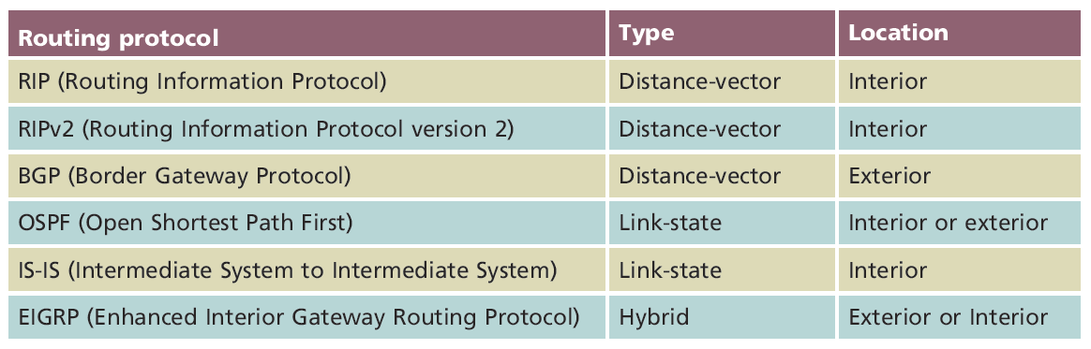
Routing Protocols (cont’d.)
Table 6-1 Summary of common routing protocols
Courtesy Course Technology/Cengage Learning

Slide 62
Gateways and Other Multifunction Devices
Gateway
Combination of networking hardware and software
Connects two systems using different formatting, communications protocols, architecture
Repackages information
Resides on servers, microcomputers, connectivity devices, mainframes
Popular gateways
E-mail gateway, Internet gateway, LAN gateway, voice/data gateway, firewall

Slide 63
Summary
Network adapter types vary
Access method, transmission speed, connector interfaces, number of ports, manufacturer, device type
Repeaters
Regenerate digital signal
Bridges can interpret the data they retransmit
Switches subdivide a network
Generally secure
Create VLANs
Various routing protocols exist

